Slide 1
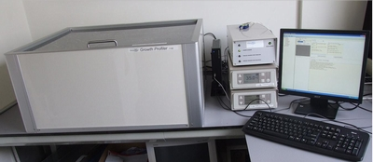
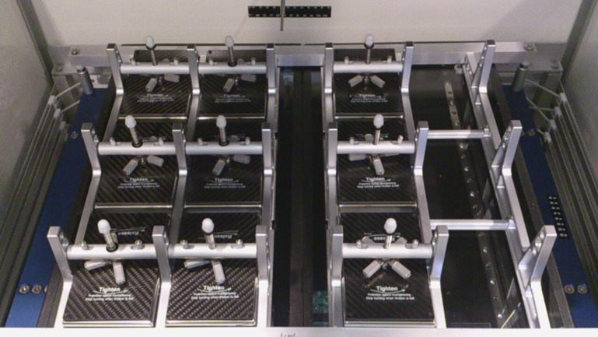
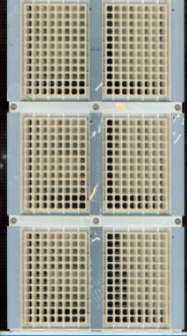
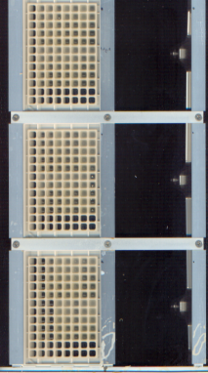
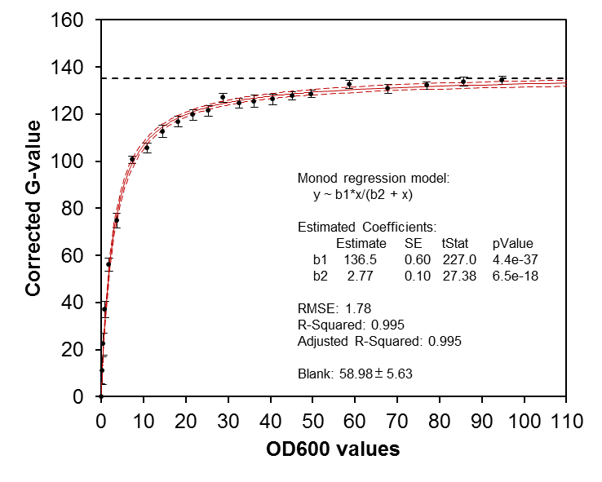
Data generation using GrowthProfiler 1152
Shakes up to 1152 microbial cultures in microtiter plates (MTPs) aseptically (kLa values up to 200 h⁻¹, Oxygen-transfer rates up 40 mmol/L/h).
Shaker unit can be set to regularly stop for 30 secs (e.g. every 20 or 60 minutes): in these 30 seconds the scanners automatically scans the bottom of the MTPs
The image analysis software quantifies the cell density in each well in terms of G-value
G-values are converted to OD equivalents using a calibration curve

Slide 2
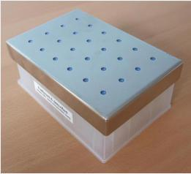
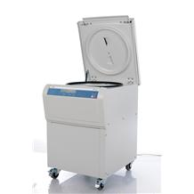
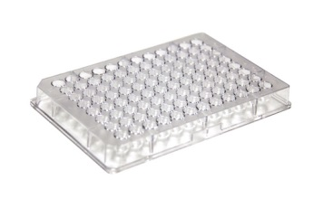
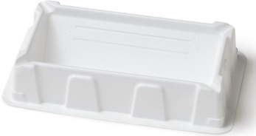
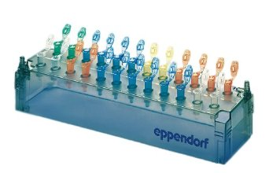
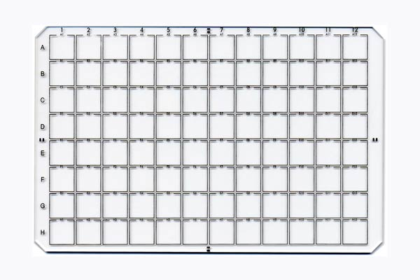
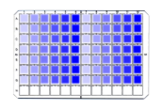
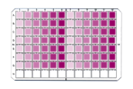
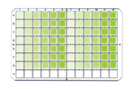
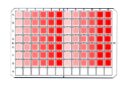
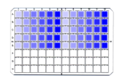
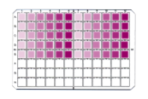
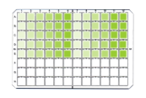
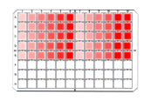
Inoculation of 12 96-well MTPs
Pre-cultures
OD measurements
20 h @ 30°C
Collect cells
Remove medium
Resuspend in water
× 2
Calculate DF
× 38
38 strains
OD 4.5
Volume > 1000 µL
Time required:
60 min
45 min
45 min
Total: 2.5 h
7 strains
7 strains

